Slide 1

AlphaMate Balance selection and maintenance of diversity under practical constraints
Gregor Gorjanc & John M Hickey

Slide 2
Breeder’s dilemma
Deliver the best product ~today (=select intensively)
Stay in business for many years (=maintain genetic diversity)
Work within practical constraints (=construct a mating plan)

Slide 3
Optimum contribution selection
Find contributions to the next generation
Objective = x^{T}a + b_{pi}*x^{T}Ax/2
(subject to practical constraints)
x contributions (0 = do not select, >0 = prop. of matings)
x^{T}a genetic gain
x^{T}Ax/2 group coancestry (=future population inbreeding)
b_{pi} population inbreeding penalty (negative)
Maximize genetic gain
Minimize loss of diversity
Subject to practical constraints

Slide 4
How to balance?
Conceptual issue of genetic gain & loss of diversity
Technical issues
scale of estimated breeding values a
scale of the relationship matrix A
pedigree (pedigree completeness)
genomic (genotypes standardized or not, which base population, …)
pedigree & genomic (aka single-step)

Slide 5
Holistic approach
Loss of diversity = increase in population inbreeding
absolute inbreeding (F) does not matter
rate of inbreeding (ΔF) does matter
Solution:
decide on the rate of inbreeding/effective population size ΔF=1/2N_{e}
formulate objective around the rate of inbreeding
Pragmatic rule of thumb maintain Ne~100 → ΔF~0.005

Slide 6
AlphaMate implementation
Objective = x^{T}a + b_{pi}*|1-ΔF/ΔF_{target}|
(subject to practical constraints)
Standardize estimated breeding values (a)
Set targeted rate of inbreeding (ΔF_{target})
For each evaluated solution
ΔF=(F_{t+1}-F_{t})/(1-F_{t})
F_{t} =1^{T}A1 present population inbreeding
F_{t+1}=x^{T}Ax future population inbreeding
The value for penalty (b_{pi}) becomes less critical

Slide 7
AlphaMate implementation
Optimum contribution selection & mating plan
Objective = x^{T}a +
b_{pi}*|1-ΔF/ΔF_{target}|+
… b_{mi}*F +
b_{v}*Pr(outlier) +
…
(subject to practical constraints)
Individual (parent)
level terms
Mating (progeny)
level terms

Slide 8
Practical constraints
Selected individuals might need to
have at least nMin matings (economical constraints)
have at most nMax matings (biological constraints)
have equal contributions
limit progeny inbreeding
…
Utilize available techniques/information
selfing, MOET, JIVET, ...
genomic data (predict mean and variance of a mating)
Cost

Slide 9
Gain-Diversity frontier
Optimum contribution mating
ΔF_{target}=0.01
Random mating
Minimum inbreeding mating

Slide 10
Implementation @ Bitbucket
AlphaMate (mate selection)
https://bitbucket.org/hickeyjohnteam/alphamate
Depends on
AlphaEvolve (evolutionary algorithms)
AlphaStat (stats)
AlphaHouse (housekeeping)
OrderPack (ranking)
https://bitbucket.org/hickeyjohnteam/alphahouse
NOTE
at the moment this is a research tool
handles discrete generations

Slide 11
AlphaMate Balance selection and maintenance of diversity under practical constraints
Gregor Gorjanc & John M Hickey

Slide 12
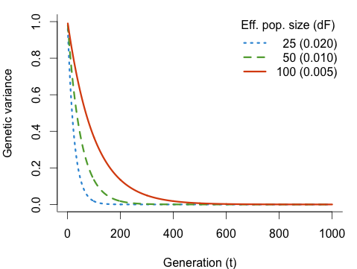
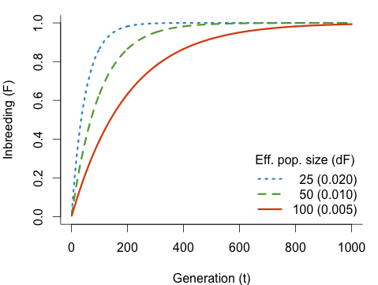
Some theory (without mutation)
Genetic variance and inbreeding over time
V_{a,t}=V_{a,0}(1-F_{t}) F_{t}=1-(1-ΔF)^{t} ΔF=1/2N_{e}
Notes:
t=1:1000
Ne=c(25,50,100)
NeC=c(" 25", " 50", "100")
(dF=1/(2*Ne))
dFC=c("0.020", "0.010", "0.005")
LegC=c(" 25 (0.020)", " 50 (0.010)", "100 (0.005)")
FFun <- function(dF,t) 1-(1-dF)^t
F1=FFun(dF=dF[1],t)
F2=FFun(dF=dF[2],t)
F3=FFun(dF=dF[3],t)
F <- cbind(F1,F2,F3)
col1 <- rgb(red= 55, green=152, blue=217, maxColorValue=255) ## blue
col2 <- rgb(red= 95, green=168, blue= 59, maxColorValue=255) ## green
col3 <- rgb(red=219, green= 79, blue= 15, maxColorValue=255) ## orange
par(mar=c(4,4,1,1), bty="l")
matplot(y=F, x=t, type="l", lwd=3,
lty=3:1, col=c(col1, col2, col3),
ylim=c(0,1), ylab="Inbreeding (F)",
xlab="Generation (t)")
legend("bottomright", title="Eff. pop. size (dF)",
legend=c(LegC), col=c(col1, col2, col3),
lty=3:1, bty="n", lwd=3)
Va=1
Va=Va*(1-F)
par(mar=c(4,4,1,1), bty="l")
matplot(y=Va, x=t, type="l", lwd=3,
lty=3:1, col=c(col1, col2, col3),
ylim=c(0,1), ylab="Genetic variance",
xlab="Generation (t)")
legend("topright", title="Eff. pop. size (dF)",
legend=c(LegC), col=c(col1, col2, col3),
lty=3:1, bty="n", lwd=3)

Slide 13
Some theory (with mutation)
Pragmatic rule of thumb maintain Ne~100 → ΔF~0.005

Slide 14
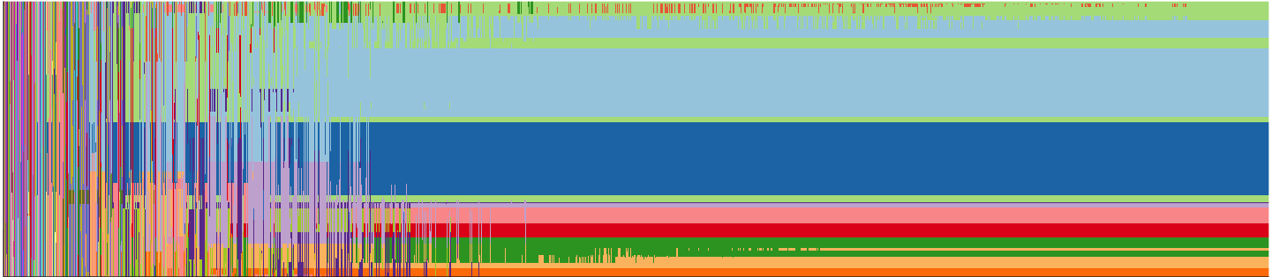
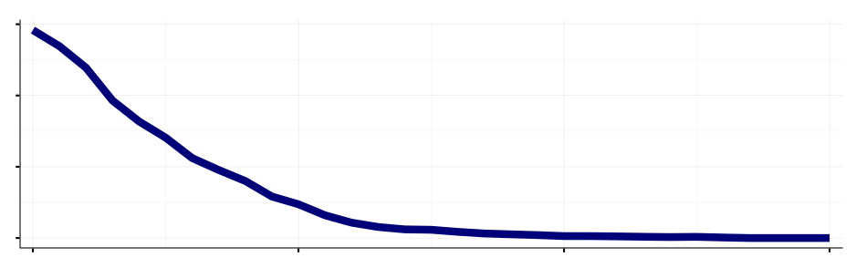
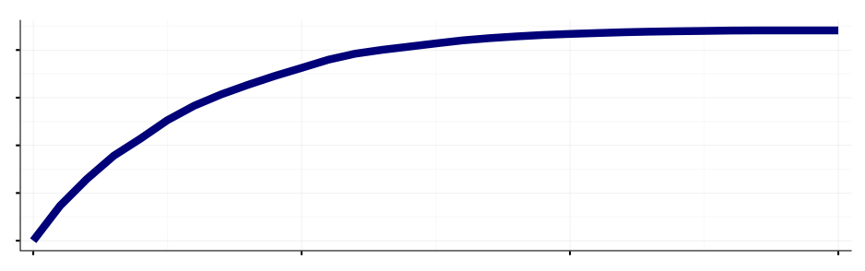
Breeder’s dilemma
Diversity x Selection intensity x Accuracy
Response =
Time x Cost
Haplotypes
Genetic variance
Genetic gain

